Slide 1


Employee Management System
EMS Developed By: Team TestHut

Slide 2
Team Members
Abdullah
Bashaer
Ghadeer
Lama Bandar

Slide 3
Introduction
Create a web-based application using a 3-tiered architecture.
The Employee Management System (EMS) will allow CRUD operations through an HTML and a RESTful interface.

Slide 4
PROJECT ENVIRONMENT
DATABASE: H-2
OPERATING SYSTEM: Windows 10, MAC X
PROGRAMMING LANGUAGE: Java Spring-boot, HTML, CSS, RESTful Service & SQL.

Slide 5
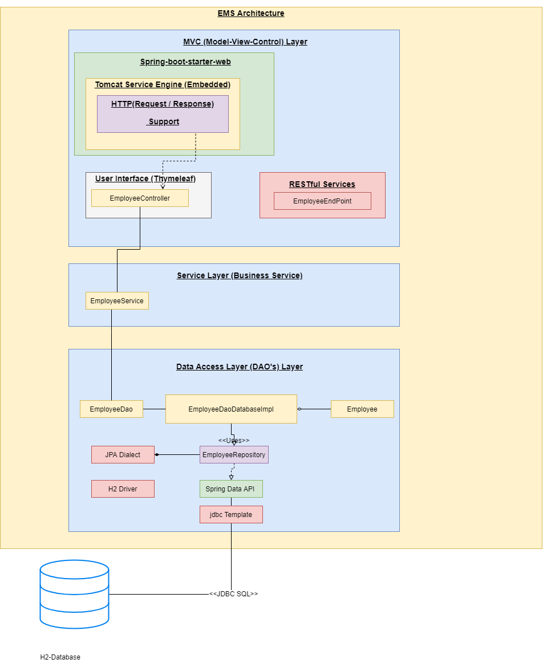
PROJECT ARCHITECTURE

Slide 6





EMS FEATURES
Add Employee
Employee
List
RESTful API
Edit Employee
Delete Employee

Slide 7
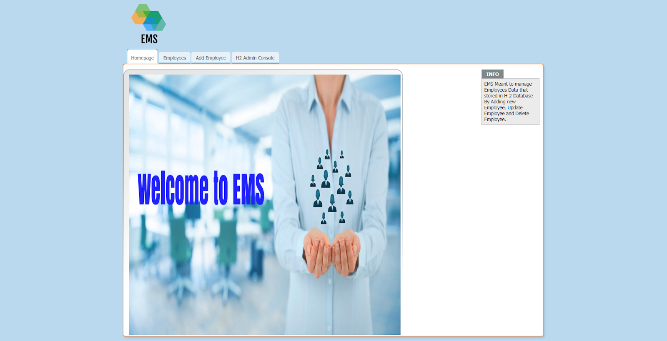
Home Page

Slide 8
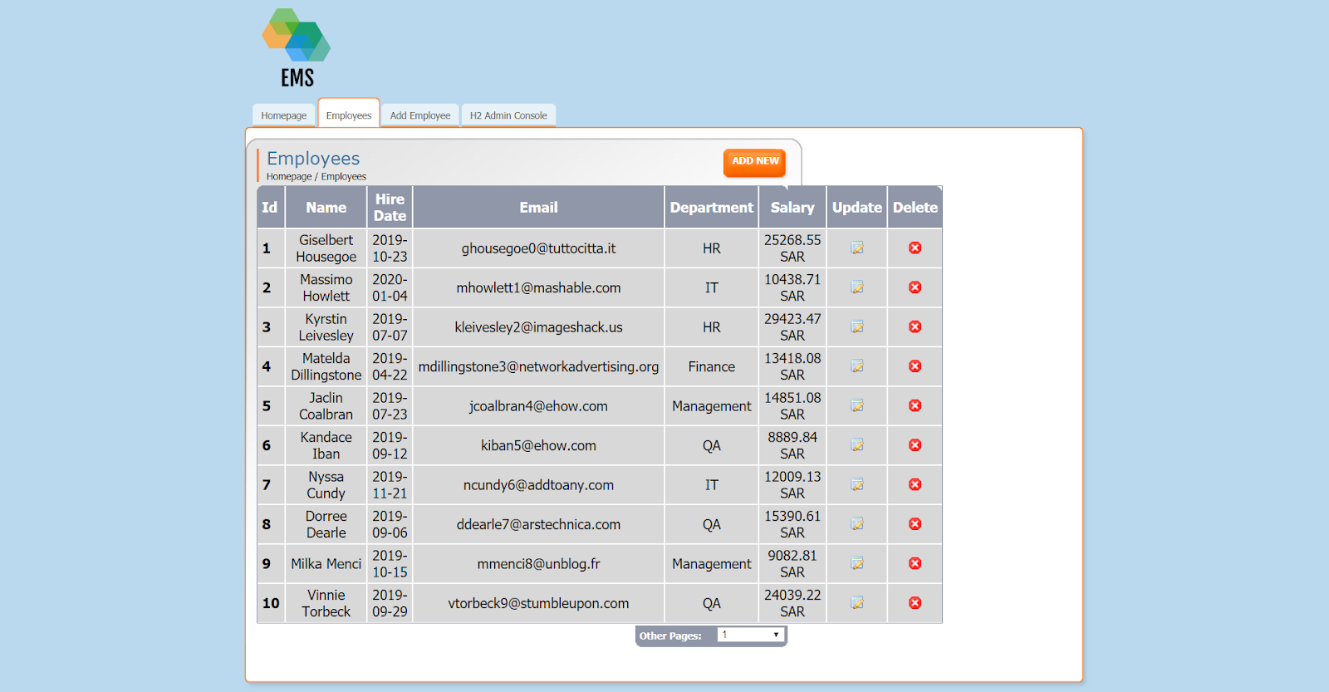
Employee List

Slide 9
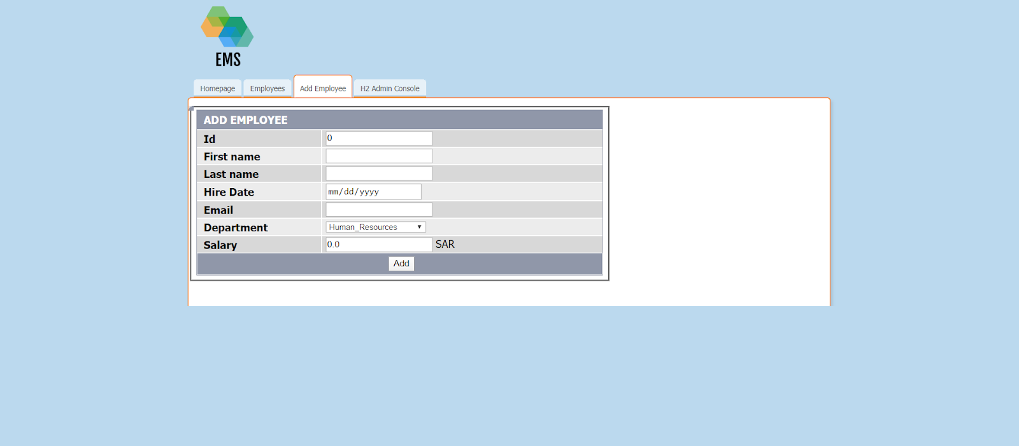
Add Employee

Slide 10
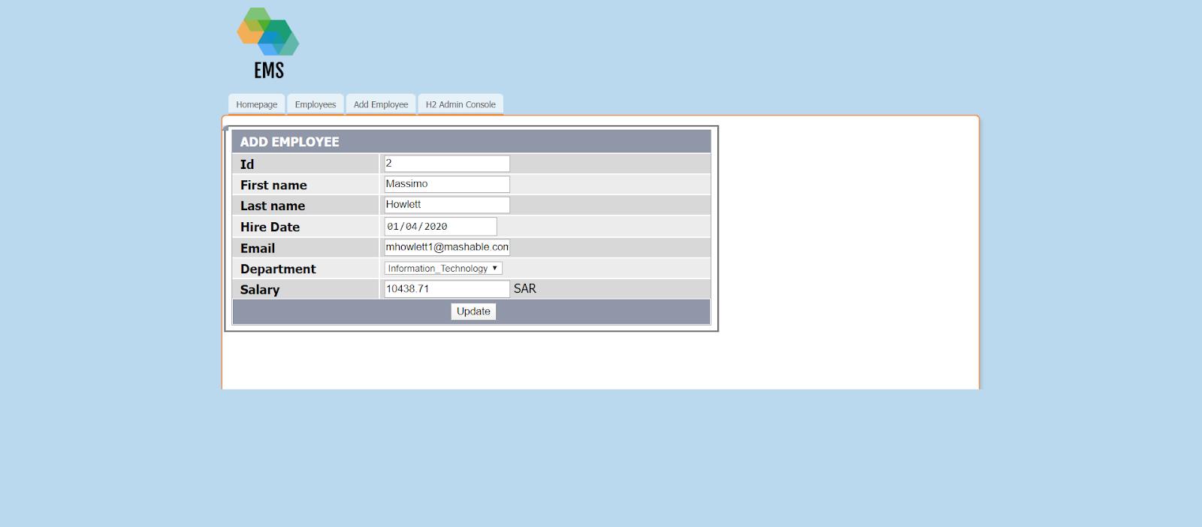
Edit Employee

Slide 11
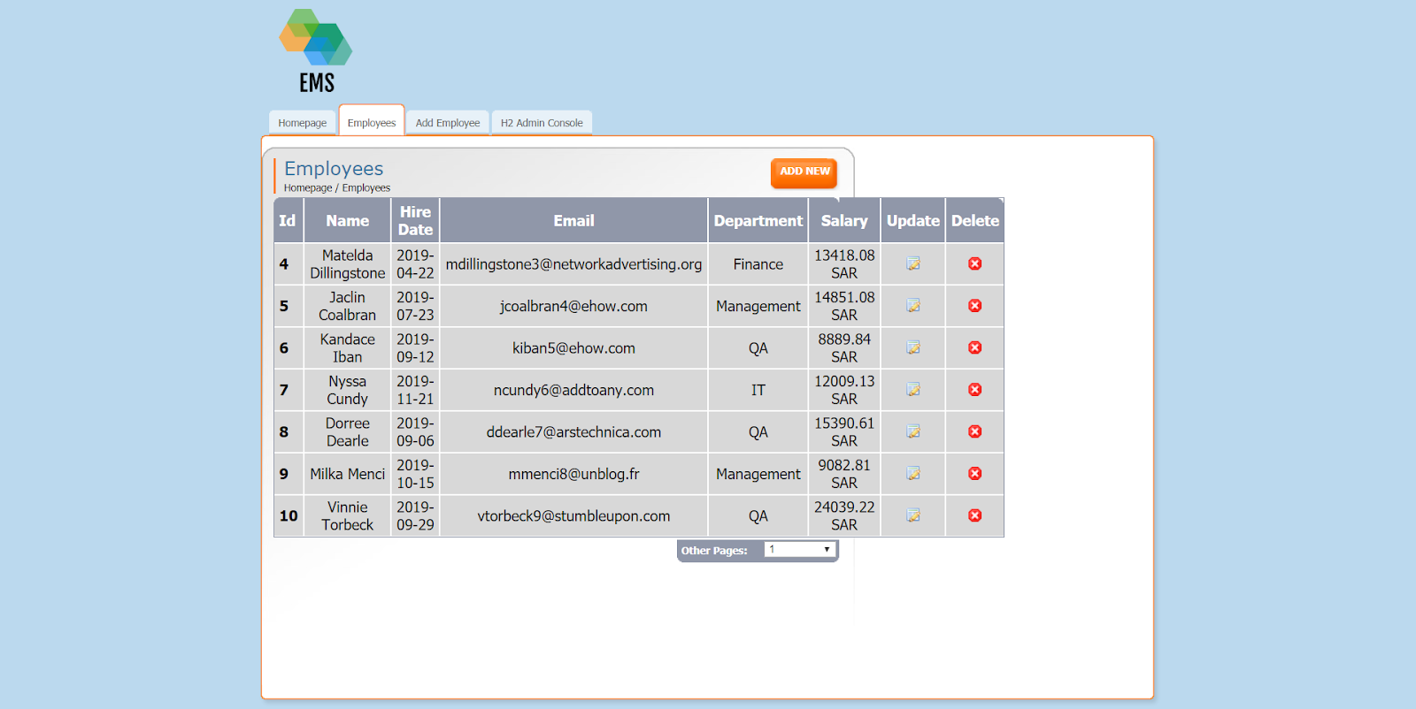
Delete Employee

Slide 12
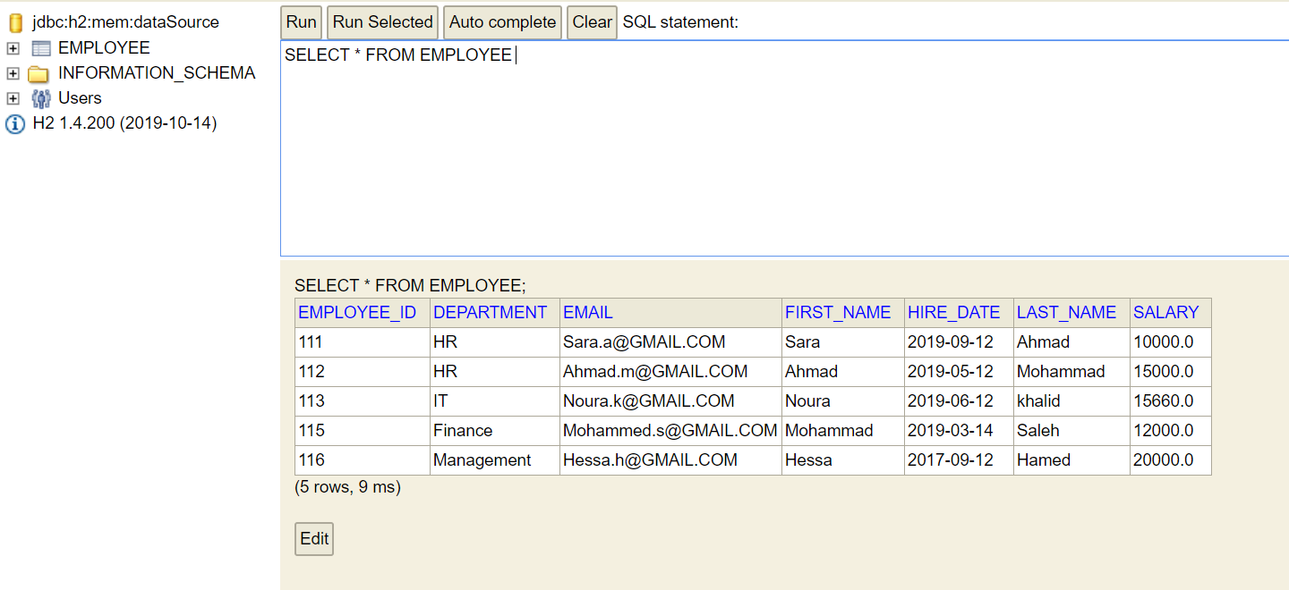
H-2 TABLE DATA

Slide 13
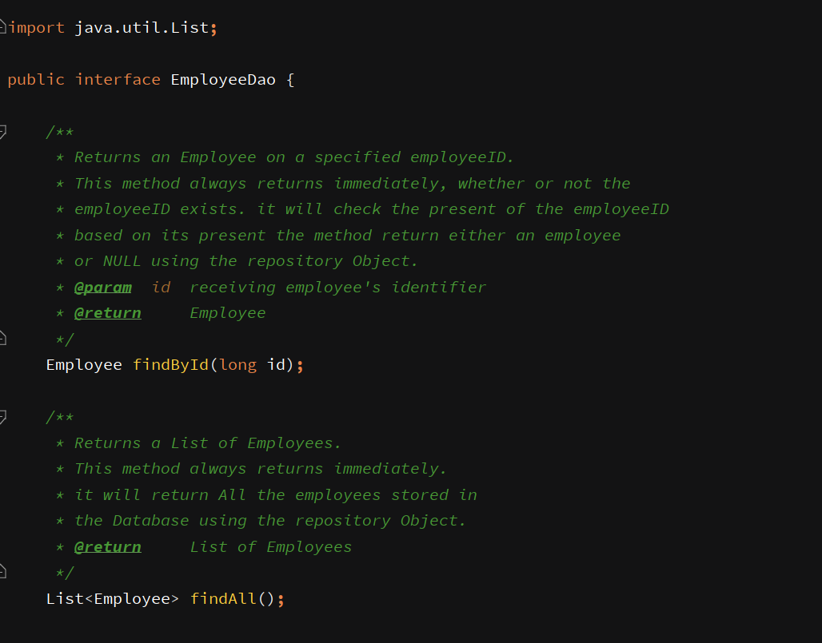
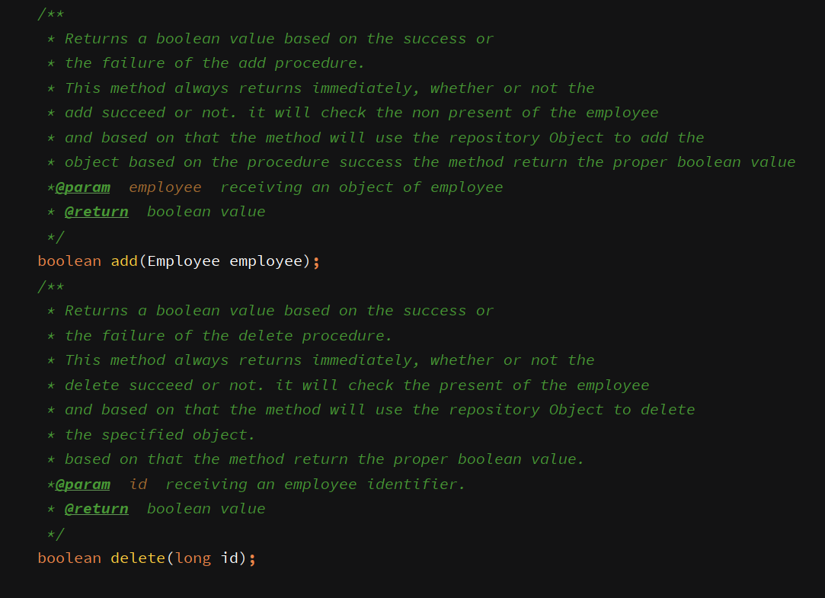
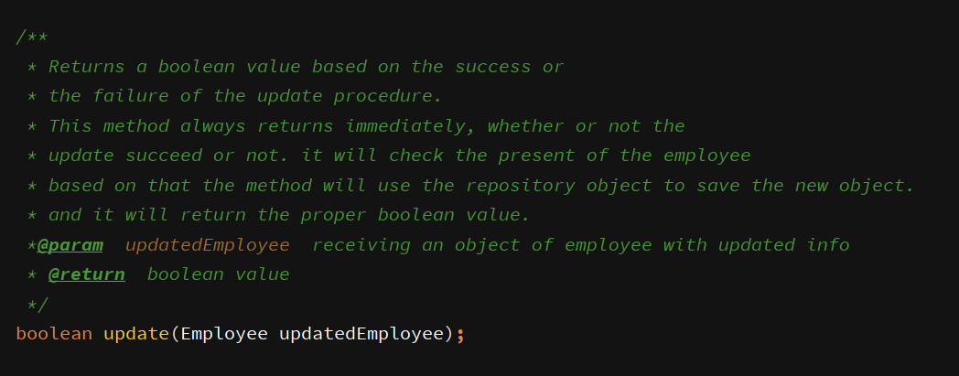
Sample Code[DAO]

Slide 14
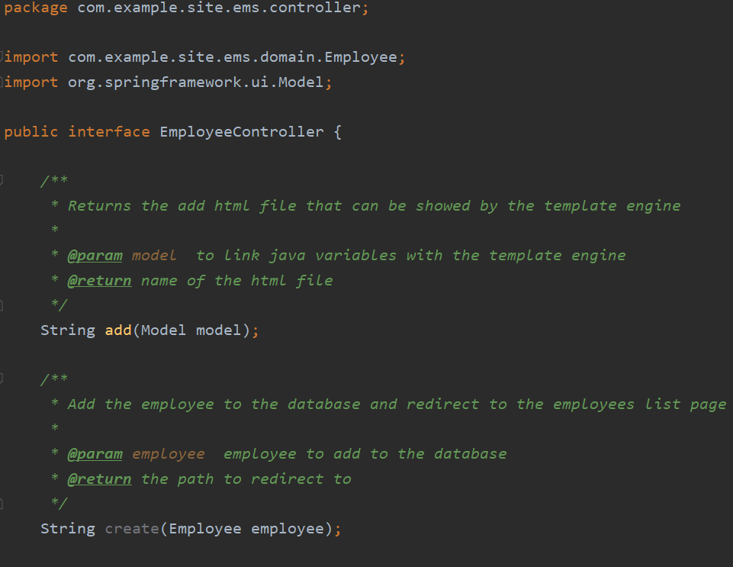
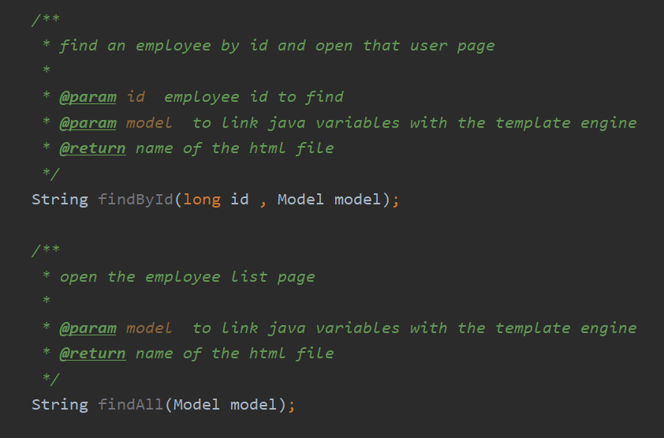
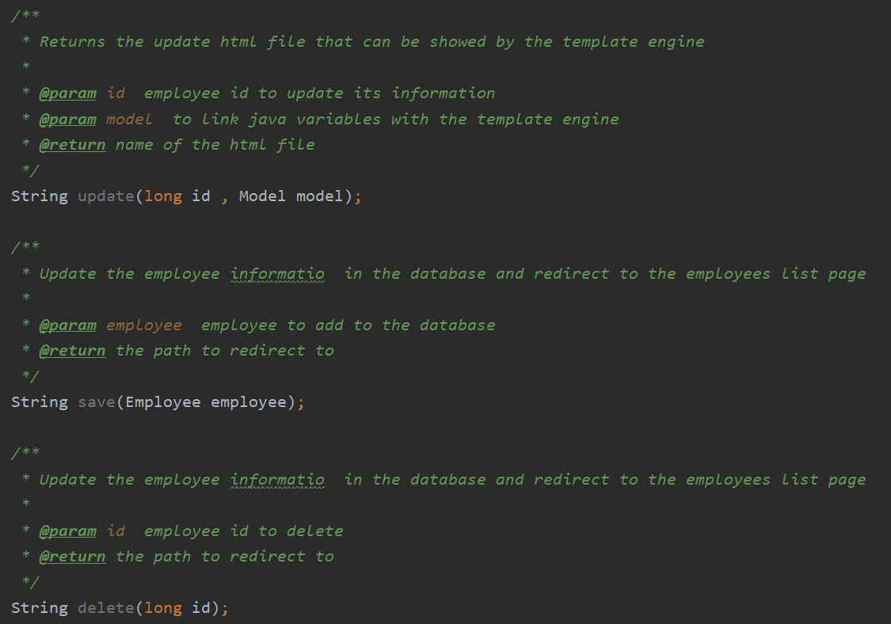
Sample Code[Controller]

Slide 15
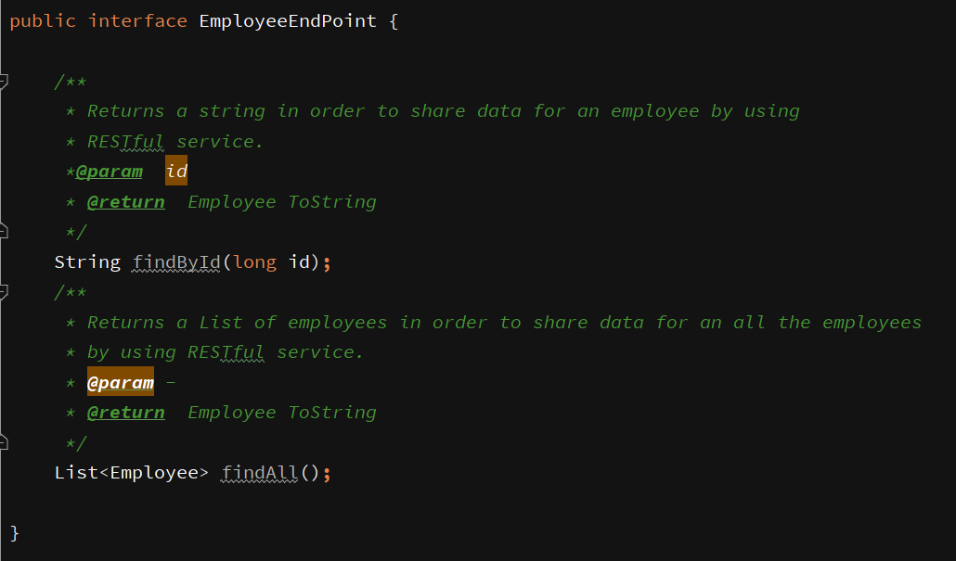
Sample Code[RESTful]

Slide 16
Source Code
https://github.com/abdullah-cs
https://github.com/Beshjot
https://github.com/Ghadeer-bnh
https://github.com/lamaBS

Slide 17
Live Demo

Slide 18
Thank You

